Slide 1
Windows Programming
CIS 577
Bruce R. Maxim
UM-Dearborn

Slide 2
Getting Started
You need Visual C++ and installed on your computer, DirectX might be desirable (but not needed for the next assignment)
DirectX can be downloaded from the Internet
You will need to known the paths for the .lib and .h files on your computer (e.g. DXSDK/LIB and DXSDK/INCLUDES)

Slide 3
Inside Visual C++
You need to create a Win32 app workspace and use the project settings dialog box to adjust the directory links so that necessary .lib files are available during complies
  Winmm.lib, Ddraw.lib, Dinput.lib, Dsound.lib
The runtime .dll files needs to be in the Windows/system32 directory
  winmm.dll, Ddraw.dll, Dinput.dll, Dsound.dll

Slide 4
John Hamill’s
Visual Studio 6.0 DirectX
Configuration Guide

Slide 5
Install C++ and DirectX SDK
Install MS Visual Studio C++ 6.0
Install DirectX SDK 9.0. The installation puts it in C:\DXSDK by default.
Install the DirectX 9.0 runtime that comes with the DirectX SDK in the following area after DirectX is installed:
    C:\DXSDK\Redist\DirectX9\dxsetup.exe

Slide 6
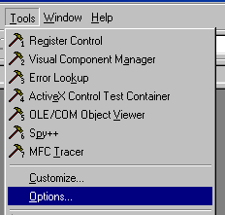
Select Option in Tools Menu

Slide 7
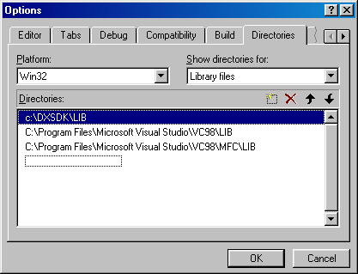
Select Directories Tab and Show Directories Library Files

Slide 8
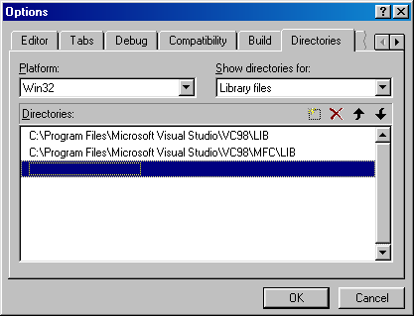
Add the Directory where the DirectX libraries were installed “C:\DXSDK\LIB” by clicking the empty dashed box twice

Slide 9
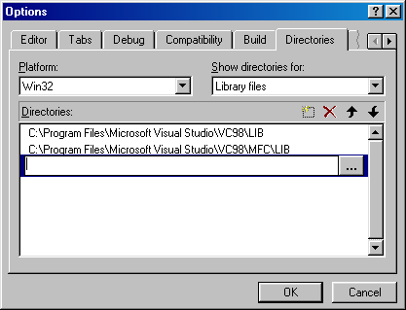
Click the […] to browse for the location of the lib directory.

Slide 10
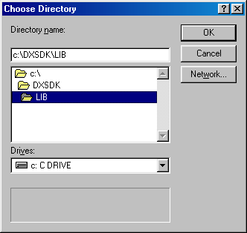
Browse and select the folder where the DXSDK\LIB is located
Click OK

Slide 11
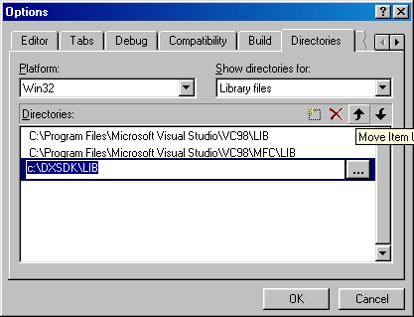
Hit Enter and then the up arrow key to leave […] input widget

Slide 12
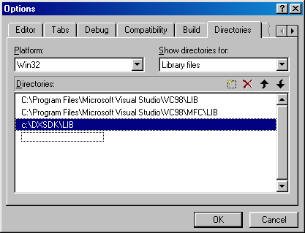
Click the up arrow icon 2 times to move this to the top

Slide 13
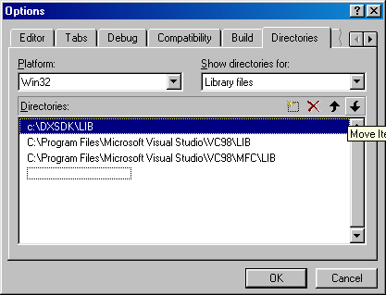
Click OK

Slide 14
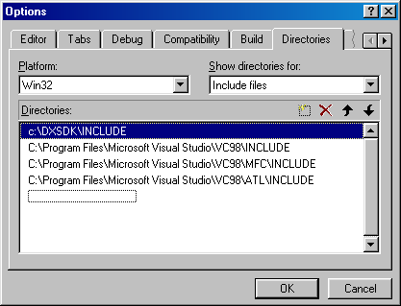
Now follow a similar procedure for the include directory

Slide 15
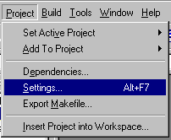
Select the Project->Setting…

Slide 16
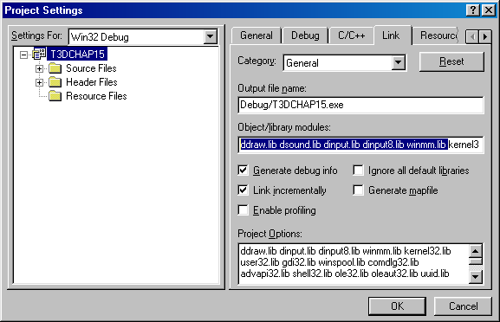
Select the Link tab
Add “ddraw.lib dsound.lib dinput.lib dinput8.lib winmm.lib “ in the “Object/library modules:” field before all the other libraries that are already in this field

Slide 17
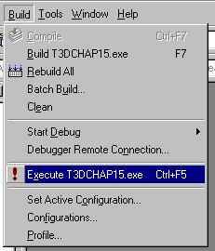
Now build and run the program.

Slide 18
DOS vs Windows
Windows is multi-tasking and supports multi-threaded applications
Windows programs are event driven which means they contain an infinite loop that continuously polls the system for events and messages

Slide 19
Microsoft Hungarian Notation
c = char
by = byte
n = int or short
i = int
x,y = short coords
cx,cy = short counts
b = boolean (int)
w = word
l = long word
dw = double word
fu = function
s = string
s2,str = /0 terminated
lp = 32 bit pointer

Slide 20
Microsoft Hungarian Notation
Function naming – capitalize first letter of each word
typedefs and constants done in all CAPS
Classes have capital C as a prefix

Slide 21
These examples come from the LaMothe text.

Slide 22
Command Line C++
// DEMO2_1.CPP - standard version
#include <stdio.h>
// main entry point for all standard
// DOS/console programs
void main(void)
{
printf("\nTHERE CAN BE ONLY ONE!!!\n");
} // end main

Slide 23
Windows Version
// DEMO2_2.CPP - a simple message box
#define WIN32_LEAN_AND_MEAN
#include <windows.h> // the main windows headers
#include <windowsx.h> // a lot of cool macros
// main entry point for all windows programs
int WINAPI WinMain(HINSTANCE hinstance,
HINSTANCE hprevinstance,
LPSTR lpcmdline,
int ncmdshow)

Slide 24
Windows Version
{
// call message box api with NULL for parent
// window handle
MessageBox(NULL, //parent window handle
"THERE CAN BE ONLY ONE!!!", //message string
"MY FIRST WINDOWS PROGRAM", //window title
MB_OK | MB_ICONEXCLAMATION); //style options
// exit program
return(0);
} // end WinMain

Slide 25
Advice
You may need to add winmm.lib to your project for Win32 apps
You always need the the same first three lines in every Windows program
WinMain is a 32-bit function that use the Pascal calling convention and always must be defined like the example

Slide 26
int ncmdshow
SW_SHOW
  Default size and position
SW_SHOWNORMAL
  Default size and position
SW_SHOWMAXIMIZED
  Display window max
SW_SHOWMINIMIZED
  Display window min

Slide 27
Window Class
Everything in Windows programming is a window (even buttons and scrollbars)
You being by declaring a Window in WinMain
WNDCLASSEX winclass;
// this will hold the class we create
HWND hwnd; // generic window handle
MSG msg; // generic message

Slide 28
Declare Windows Fields
winclass.cbSize = sizeof(WNDCLASSEX);
winclass.style = CS_DBLCLKS | CS_OWNDC |
CS_HREDRAW | CS_VREDRAW; //set style
winclass.lpfnWndProc = WindowProc; //set eventhandler
winclass.cbClsExtra = 0;
winclass.cbWndExtra = 0;
winclass.hInstance = hinstance; //application instance
winclass.hIcon = LoadIcon(NULL, IDI_APPLICATION);
winclass.hCursor = LoadCursor(NULL, IDC_ARROW);
winclass.hbrBackground =
(HBRUSH)GetStockObject(BLACK_BRUSH);
winclass.lpszMenuName = NULL;
winclass.lpszClassName = WINDOW_CLASS_NAME;
winclass.hIconSm = LoadIcon(NULL, IDI_APPLICATION);

Slide 29
Creating Windows
// register the window class
if (!RegisterClassEx(&winclass)) return(0);
// create the window
if (!(hwnd =
CreateWindowEx(NULL, // extended style
WINDOW_CLASS_NAME, // class
"Your Basic Window", // title
WS_OVERLAPPEDWINDOW | WS_VISIBLE,
0,0, // initial x,y
400,400, // initial width, height
NULL, // handle to parent
NULL, // handle to menu
hinstance,// instance of this application
NULL))) // extra creation parms
return(0);

Slide 30
Displaying the Window
You could use
  ShowWindow(hwnd, SW_SHOW);
You could use
  UpdateWindow();
Let’s look at how the window would be displayed during the course in an executing application

Slide 31
Event Handler
LRESULT CALLBACK WindowProc
(HWND hwnd, UINT msg, WPARAM wparam, LPARAM lparam)
{
// this is the main message handler of the system
PAINTSTRUCT ps; // used in WM_PAINT
HDC hdc; // handle to a device context
// what is the message
switch(msg)
{
} // end switch
// process any messages that we didn't take care of
return (DefWindowProc(hwnd, msg, wparam, lparam));
} // end WinProc

Slide 32
Processing Messages - 1
case WM_CREATE:
{
// do initialization stuff here
return(0); // return success
} break;
case WM_PAINT:
{
// simply validate the window
hdc = BeginPaint(hwnd,&ps);
// you would do all your painting here
EndPaint(hwnd,&ps);
return(0); // return success
} break;

Slide 33
Processing Messages - 2
case WM_DESTROY:
{
// kill the application, this sends a WM_QUIT message
PostQuitMessage(0);
return(0); // return success
} break;
default:break;
} // end switch

Slide 34
Main Event Loop
// enter main event loop
while(GetMessage(&msg,NULL,0,0))
{
// translate any accelerator keys
TranslateMessage(&msg);
// send the message to the window proc
DispatchMessage(&msg);
} // end while
// return to Windows desktop like this
return(msg.wParam);

Slide 35
Different Main Event Loop
while(TRUE)
{
//if there is a message in queue get it
if (PeekMessage(&msg,NULL,0,0,PM_REMOVE))
{
// test if this is a quit
if (msg.message == WM_QUIT)
break;
// translate any accelerator keys
TranslateMessage(&msg);
// send the message to the window proc
DispatchMessage(&msg);
} // end if
} // end while

Slide 36
Processing Messages
You can handle Windows event messages yourself by adding more sections to the switch statement in the callback function (WinProc)
What kinds of stuff?
  Close window
  Force repaint
  Kill application

Slide 37
Two Ways
Postmessage( )
  Sends message to queue for normal processing
  Postmessage(hwnd, WM_USER,w,l);
Sendmessage( )
  Sends message to window, bypassing queue and requiring immediate response
  Sendmessage(hwnd, WM_USER,w,l);

Slide 38
Add to Switch
case WM_USER:
{
// wparam is the value passed as w
// lparam is the value passed as l
}
wparam and lparam are flags and will contain different information depending the message being sent to the window

Slide 39
Movable Window - 1
case WM_MOVE:
{
// extract the position
int xpos = LOWORD(lparam);
int ypos = HIWORD(lparam);
// get a graphics context
hdc = GetDC(hwnd);
// set the foreground color to green
SetTextColor(hdc, RGB(0,255,0));
// set the background color to black
SetBkColor(hdc, RGB(0,0,0));

Slide 40
Movable Window - 2
// set the transparency mode to OPAQUE
SetBkMode(hdc, OPAQUE);
// draw the size of the window
sprintf(buffer,
"WM_MOVE Called - New Positition = (%d,%d)",
xpos, ypos);
TextOut(hdc, 0,0, buffer, strlen(buffer));
// release the dc back
ReleaseDC(hwnd, hdc);
} break;

Slide 41
Keyboard Input
To process key presses use the message WM_CHAR
wparam = ASCII character code
  (there are several predefined like VK_UP)
lparam = bit code for key state
  0-15 repeat count
  16-23 scan code
  24 extended key
  25-28 reserved
  29 boolean – key down
  30 boolean – state same as last time
  31 boolean – 0=key being pressed, 1=key being released

Slide 42
WM_CHAR
case WM_CHAR:
{
// get the character
char ascii_code = wparam;
unsigned int key_state = lparam;
// get a graphics context
hdc = GetDC(hwnd);
// set the foreground color to green
SetTextColor(hdc, RGB(0,255,0));
// set the background color to black
SetBkColor(hdc, RGB(0,0,0));
// set the transparency mode to OPAQUE
SetBkMode(hdc, OPAQUE);

Slide 43
WM_CHAR
// print the ascii code and key state
sprintf(buffer,"WM_CHAR: Character = %c ",ascii_code);
TextOut(hdc, 0,0, buffer, strlen(buffer));
sprintf(buffer,"Key State = 0X%X ",key_state);
TextOut(hdc, 0,16, buffer, strlen(buffer));
// release the dc back
ReleaseDC(hwnd, hdc);
} break;

Slide 44
Other Key Messages
WM_KEYDOWN
  Sent whenever any key is pressed
WM_KEYUP
  Sent whenever depressed key is released
You can also bypass the message passing scheme by using the function GetAsynchKeyState( )

Slide 45
WM_KEYDOWN
case WM_KEYDOWN:
{
int virtual_code = (int) wparam;
int key_bits = (int) lparam;
switch (virtual_code)
{
case VK_RIGHT: { } break;
case VK_LEFT: { } break;
default: { } break;
} //end switch
} // end case

Slide 46
Mouse Events
The message WM_MOUSEMOVE is sent any time the mouse moves inside a window
  wparam = button state bits
  lparam = LOWORD is x position
  HIWORD is y position
Several button constants
  MK_LBUTTON, MK_MBUTTON, MK_RBUTTON, MK_CONTROL, MK_SHIFT

Slide 47
MK_MOUSEMOVE
case WM_MOUSEMOVE:
{
// get the position of the mouse
int mouse_x = (int)LOWORD(lparam);
int mouse_y = (int)HIWORD(lparam);
// get the button state
int buttons = (int)wparam;
// get a graphics context
hdc = GetDC(hwnd);
// set the foreground color to green
SetTextColor(hdc, RGB(0,255,0));
// set the background color to black
SetBkColor(hdc, RGB(0,0,0));
// set the transparency mode to OPAQUE
SetBkMode(hdc, OPAQUE);

Slide 48
MK_MOUSEMOVE
// print the ascii code and button state
sprintf(buffer,"Mouse (X,Y) = (%d,%d) ",mouse_x,mouse_y);
TextOut(hdc, 0,0, buffer, strlen(buffer));
sprintf(buffer,"Right Button = %d ",
((buttons & MK_RBUTTON) ? 1 : 0));
TextOut(hdc, 0,16, buffer, strlen(buffer));
sprintf(buffer,"Left Button = %d ",
((buttons & MK_LBUTTON) ? 1 : 0));
TextOut(hdc, 0,32, buffer, strlen(buffer));
// release the dc back
ReleaseDC(hwnd, hdc);
} break;

Slide 49
Button Events
WM_LBUTTONDBLCLK
WM_LBUTTONDOWN
WM_LBUTTONUP
WM_MBUTTONDBLCLK
WM_MBUTTONDOWN
WM_MBUTTONUP
WM_RBUTTONDBLCLK
WM_RBUTTONDOWN
WM_RBUTTONUP

